Slide 1
Introduction to Programming in Python
Ezekiel Adebayo Ogundepo (@gbganalyst)

Slide 2
Programming in Python

Slide 3
What is programming?
Programming is a way of instructing the computer to perform various tasks. These instructions are written in a language that the computer understands. The instruction could be as simple as:
Adding the population of Ethiopia and Sudan.
What is the square root of 16?
Just like Ethiopians can understand Amharic, Somalia understand Somali, Kenyans and Ugandans understand Swahili, so is the case with computers. Computers understand instructions that are written in a specific syntax called a programming language.

Slide 4
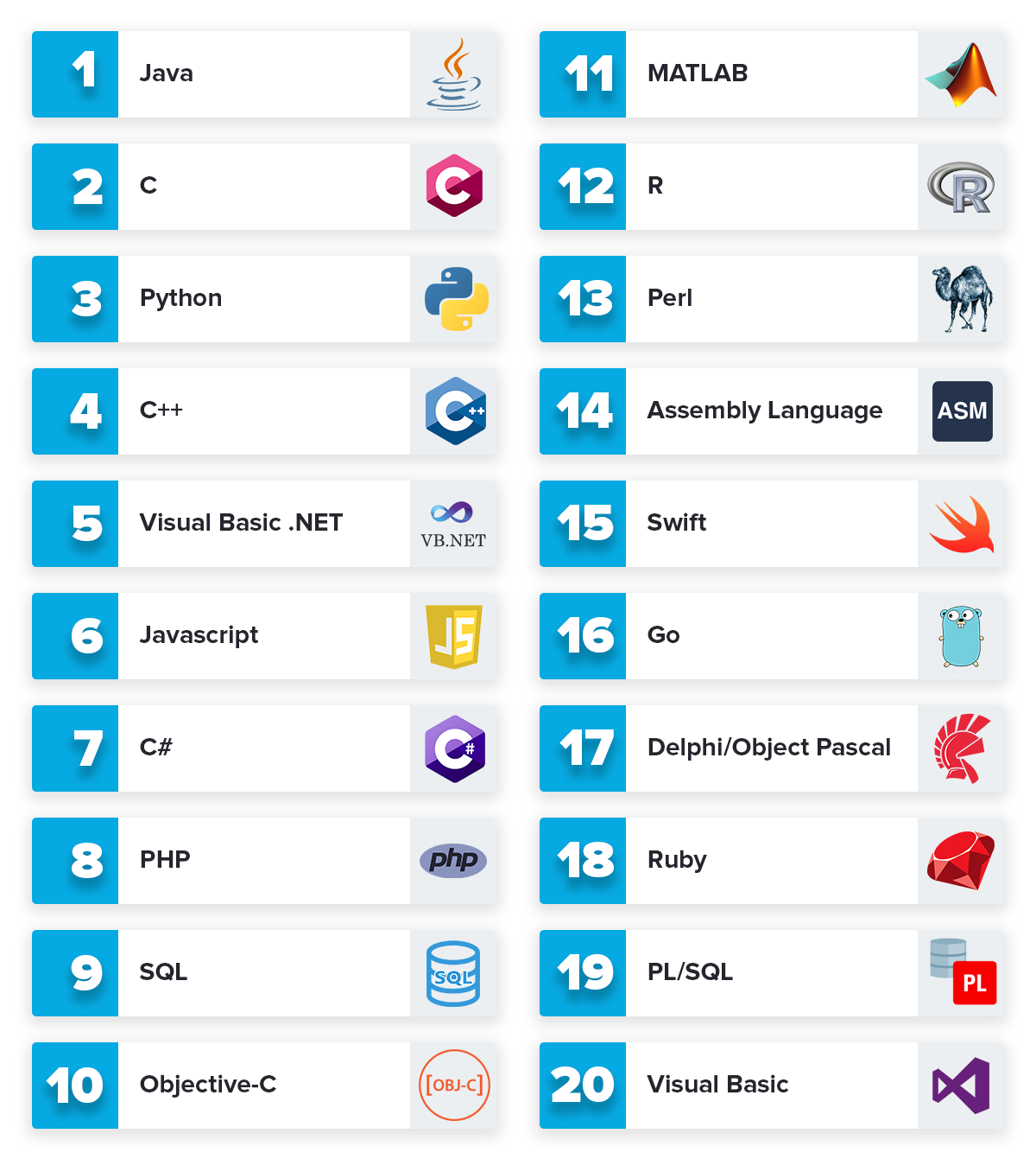
Various programming languages
Popular programming languages for data science are Python, R, and Julia.

Slide 5
Why learning computer programming?
Programming is fun
Programming increases your critical thinking
You can automate a task easily
You can earn more money by coding
The backbone of a Technology Company

Slide 6
Python Programming language
Python is one of the most popular programming languages
It is a general-purpose programming language
It was developed by Guido van Rossum in 1991
It is easy to learn and the code is readable.
It is an open-source

Slide 7

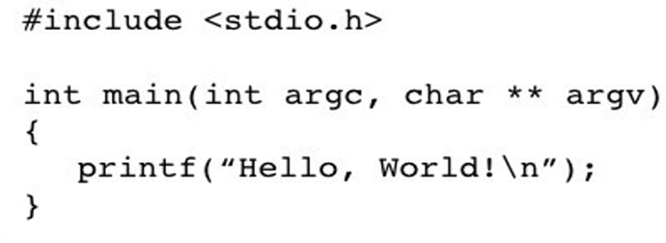
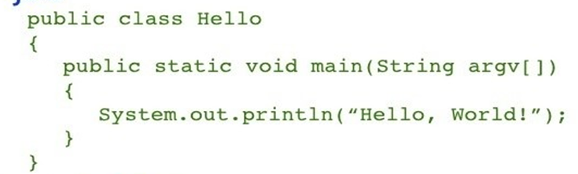
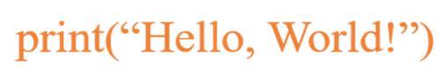
Python Programming language
Instructions are given in a shorter code compared to other programming languages
C
Java
Python

Slide 8
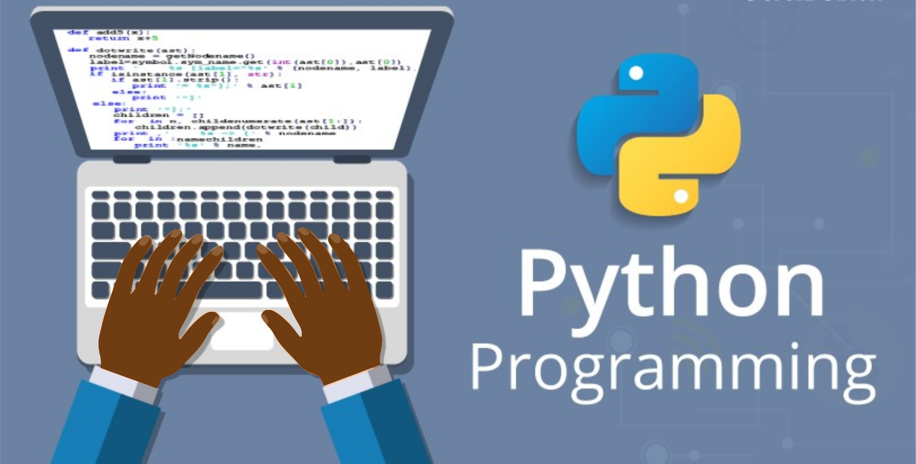

Python Programming language

Slide 9

Thank you for Listening!

